Slide 1
RADV Risk Adjustment Data Validation Tool
FHIRed UP
Augusto Burgos aburgos3@gatech.edu Spiro Ganas spiroganas@gmail.com Anja Guillory anjag1993@gmail.com Jamie Richgels jrichgels3@gatech.edu Daniel Stoneburner dstoneburner3@gatech.edu Tala Suidan tmsuidan@gatech.edu

Slide 2
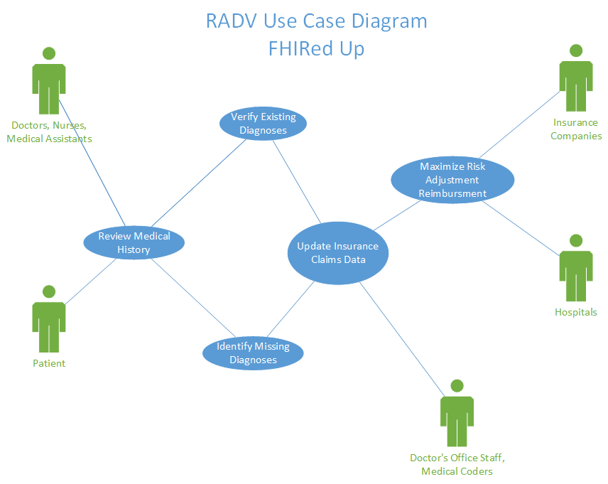
Use Case Diagram
Key Goals:
Verify diagnoses
Identify past conditions that need to be reviewed
Improve payments from the ACA risk adjustment process
Improve medical record data quality

Slide 3
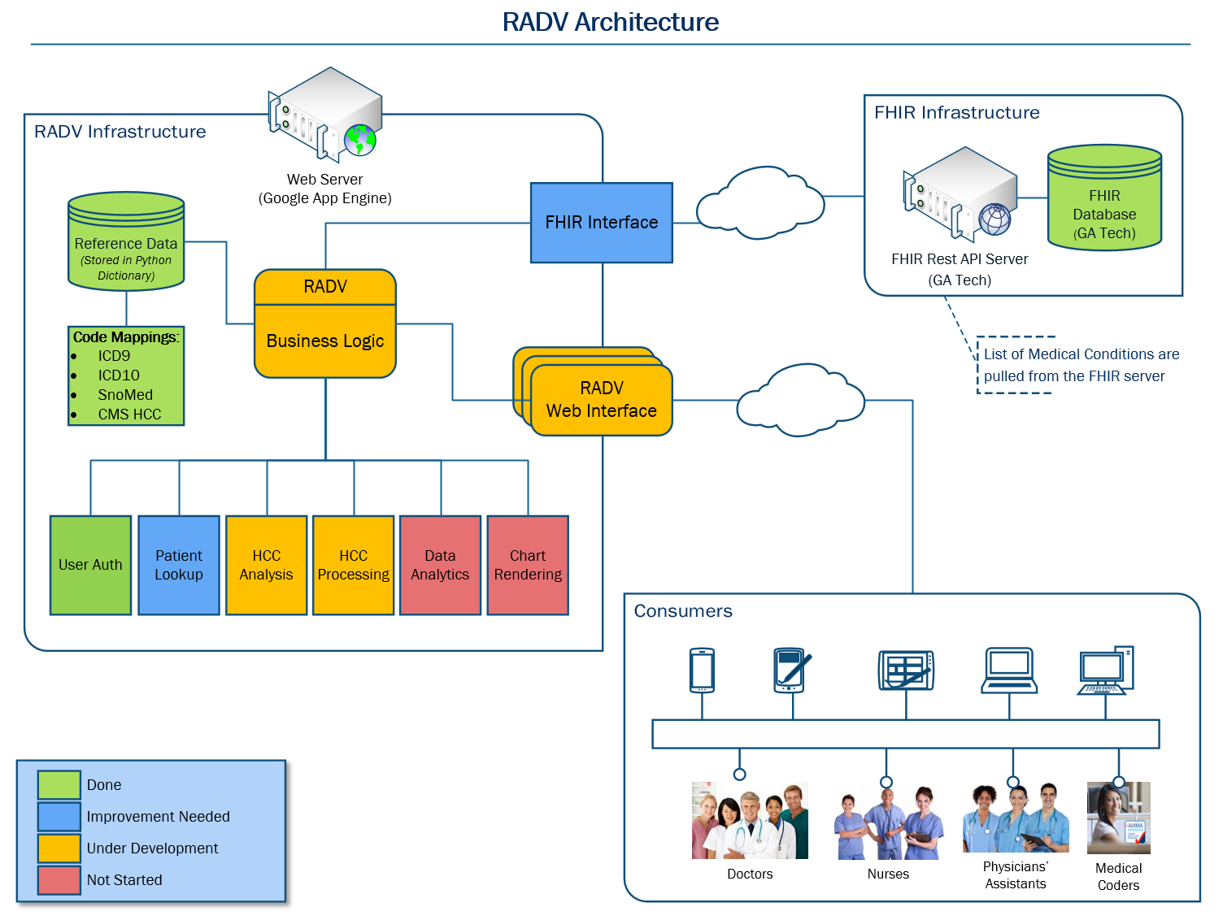

Slide 4


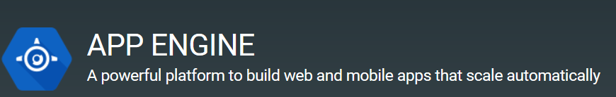
Implementation Tools & Languages
Data Tier
GaTech FHIR Server
Application Tier
Python Code
Presentation Tier
Google App Engine
HTML5
CSS
JavaScript

Slide 5
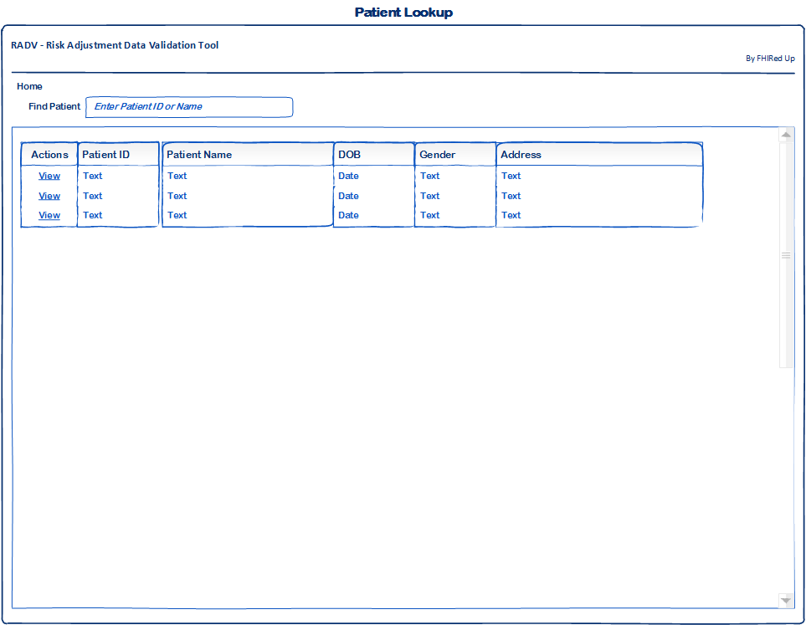
Wireframes – Patient Lookup

Slide 6
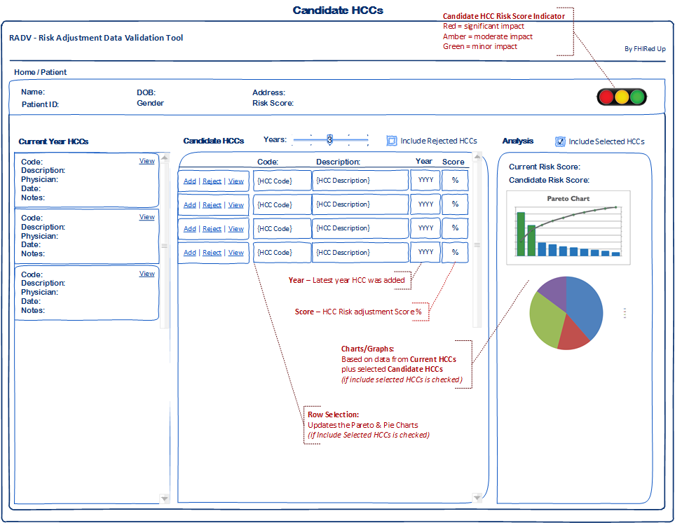
Wireframes – Candidate HCCs

Slide 7
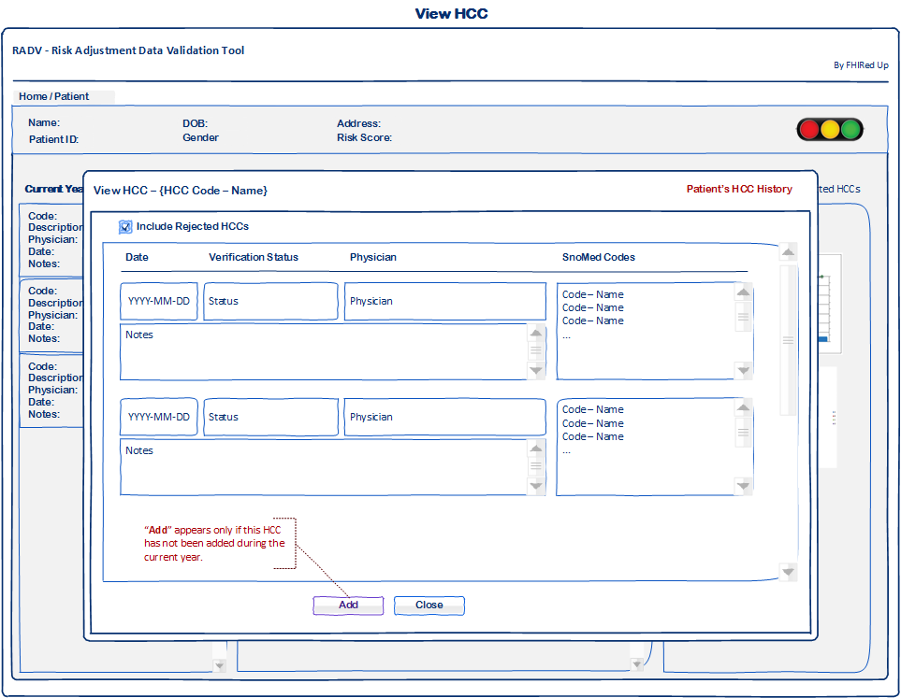
Wireframes – Viewing HCCs

Slide 8
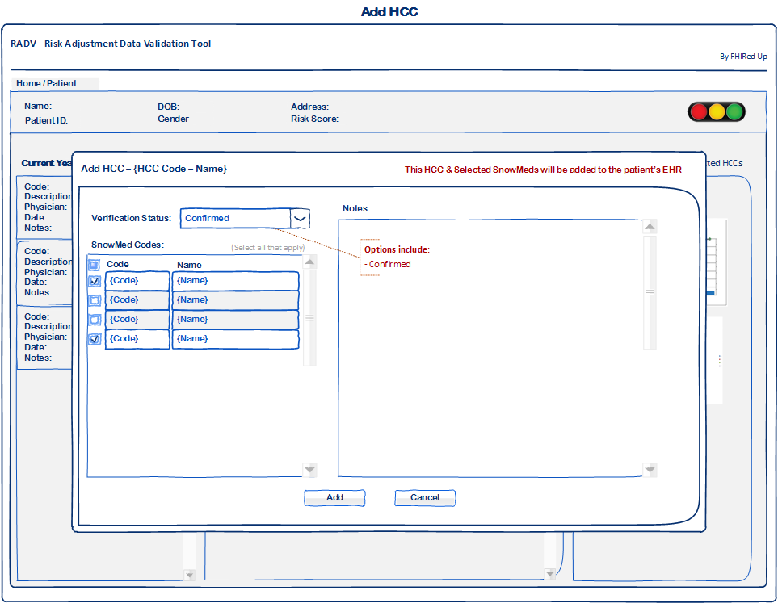
Wireframes – Adding an HCC

Slide 9
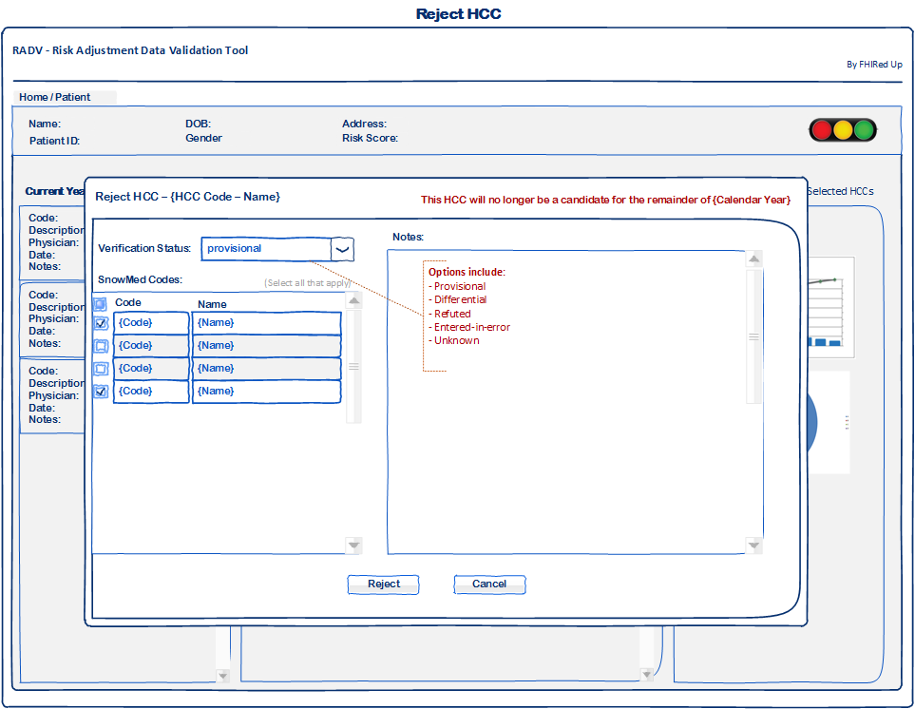
Wireframes – Rejecting an HCC

Slide 10
Data Analysis – Charts & Graphs

Slide 11
Updated Gantt Chart
* All team members involved † - Developers and testers involved ‡ - Business Analysts involved
Milestones and tasks in purple and dark blue are complete. Remainder are in progress or in the future

Slide 12
Concerns & Other Issues

Slide 13
References
Slide 3 images are from:
http://decompressionprosmarketing.com/blogs/decompression-pros/16891112-how-to-ask-for-referrals-from-medical-doctors
http://www.libertynursingagency.com/
http://allhealthcare.monster.com/training/articles/1822-5-steps-to-becoming-a-medical-assistant
http://greenfieldcc.3dcartstores.com/Medical-Coding-and-Billing_p_1058.html
Slide 4 Image from:
https://www.hl7.org/fhir/
https://www.python.org/

